Slide 1
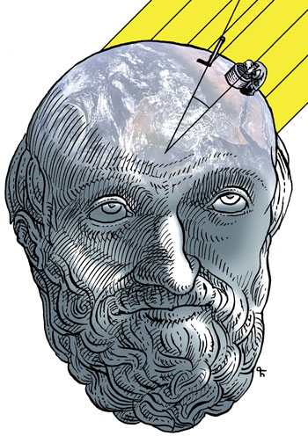
ERATOSTEN

Slide 2
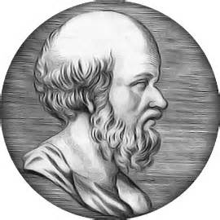
Ko je bio Eratosten? Who was Eratosthenes?
Matematičar
Pesnik
Atletičar
Geograf
Astronom
Upravnik biblioteke u Aleksandriji
mathematician
poet
athlete
geographer
astronomer
The governor of the library in Alexandria

Slide 3
Rodio se u Kireni (danas Libija) oko 276 p. n. e.
Školovao se u Aleksandriji i Atini(učenik Kalimahov i Zenonov)
Napisao naučno delo Geografija u tri knjige I tako postao pravi tvorac te nauke
He was born in (now Libya) about 276 before Christ
He was educated in Alexandria and Athens
Written scientific work Geography of the three books I became the real creator of this science

Slide 4
Eratostenovi doprinosi Eratosthenes contributions
Osmislio je metod izdvajanja prostih brojeva(poznat kao Eratostenovo sito)
He invented the method of allocation of prime numbers (known as the Sieve of Eratosthenes)

Slide 6
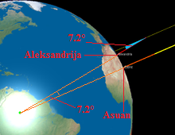
Merio je udaljenosti od Sunca do Zemlje, danas nazvana astronomska jedinica
Measure the distance from the Sun to the Earth, now called the astronomical unit

Slide 7
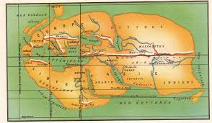
Izradio prvu mapu sveta zasnovanu na meridijanima geografske dužine I paralelama geografske širine.
Developed first world map based on the meridians of longitude and parallels of latitude

Slide 8
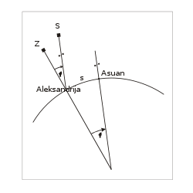
Eratosten je prvi čovek koji je izmerio Zemlju.
Eratosthenes was the first man to measure the Earth.

Slide 9
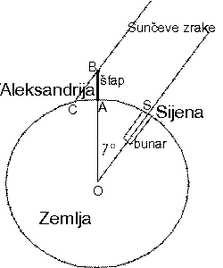

Slide 10
Bio je na glasu po svom bahatom karakteru. Oslepeo je 195 p. n. e. a godinu kasnije izgladnio se na smrt.
He was known for his arrogant character. Blind 195 p. n. e. a year later starved to death.

Slide 11
Izvori :
O Eratostenu Wikipedia
Matematicki blog - m4t3m4t1k4

Slide 12
Prezentaciju radile:
TIJANA ZIVKOV
MARIJA TORLAKOVIC

Slide 13
HVALA NA PAZNJI
Thank you for your attention

