Slide 1
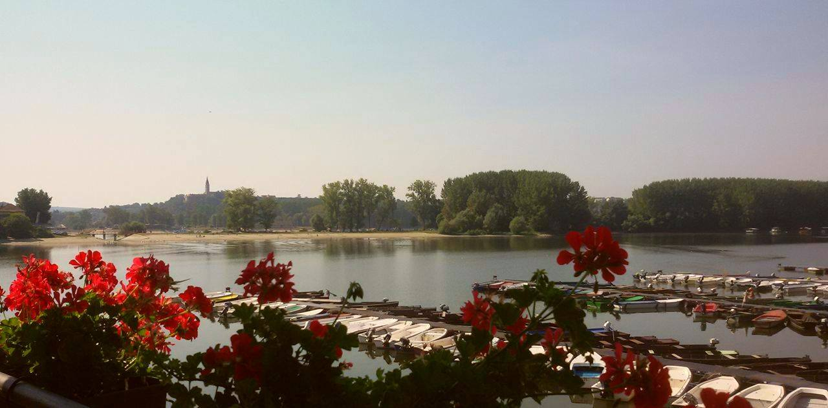
BAČKA PALANKA
Septembar, 2016

Slide 2
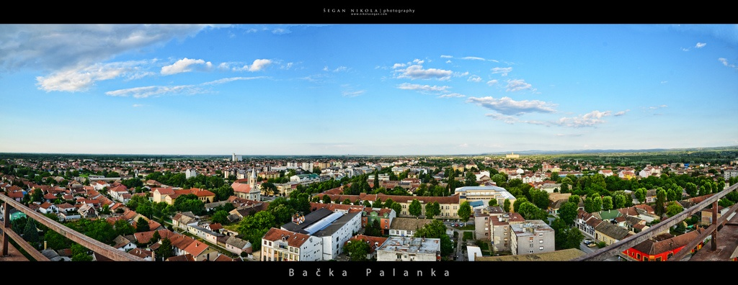

Slide 3
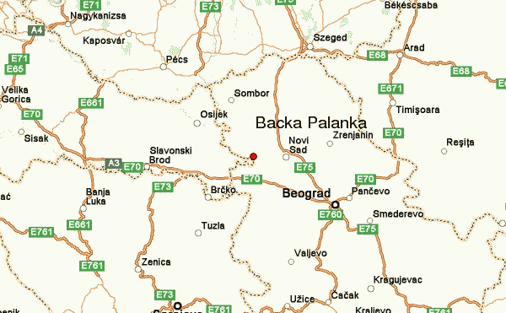
longitude 45.248431, latitude 19.382455

Slide 4
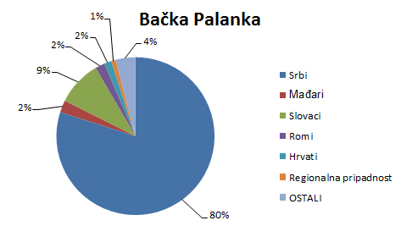
Prema popisu iz 2011 godine Bačka Palanka imala je 60.000 stanovnika.
According to the census of 2011. Backa Palanka had 60000 inhabitants

Slide 5
U gradu Bačka Palanka postoje tri osnovne i tri srednje škole.
In Backa Palanka, there are three primary and three secondary schools

Slide 6
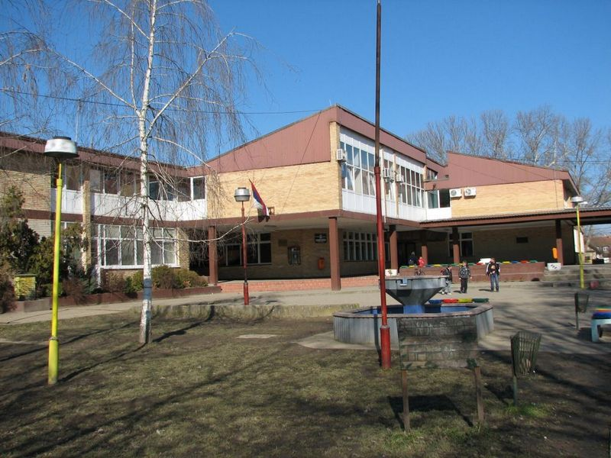
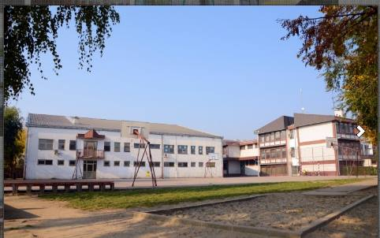
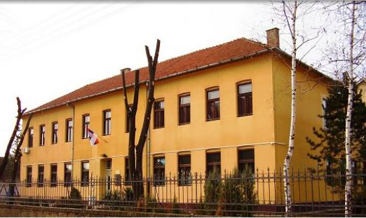
Osnovne škole
Primary schools

Slide 7
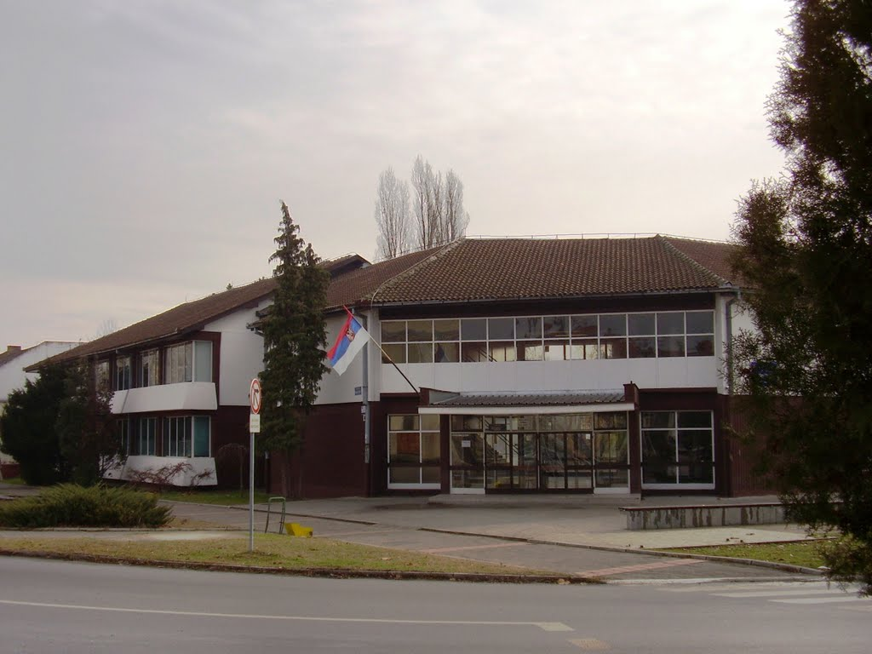
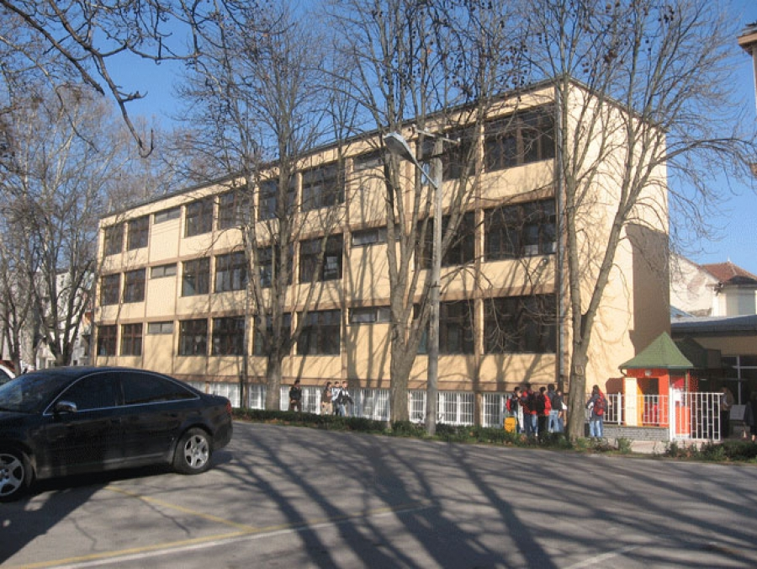
Srednje škole
Secondary schools
Tehnička škola
Tehnical school
Gimnazija i ekonomska škola
Gimnazium and economic school

Slide 8
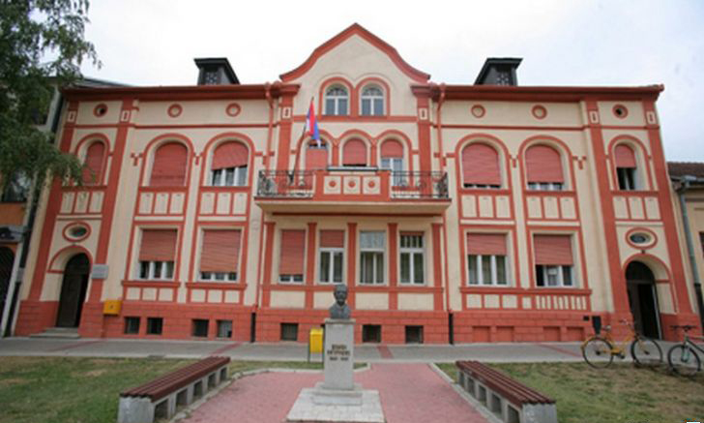
Biblioteka “Veljko Petrović”
National Library “Veljko Petrović”

Slide 9
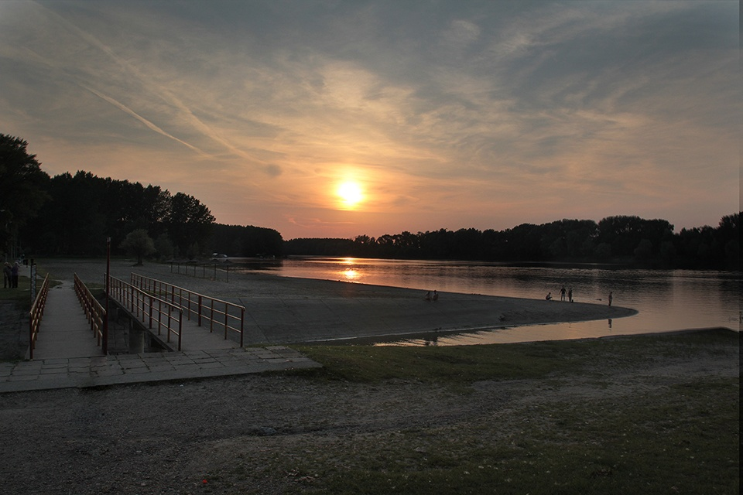
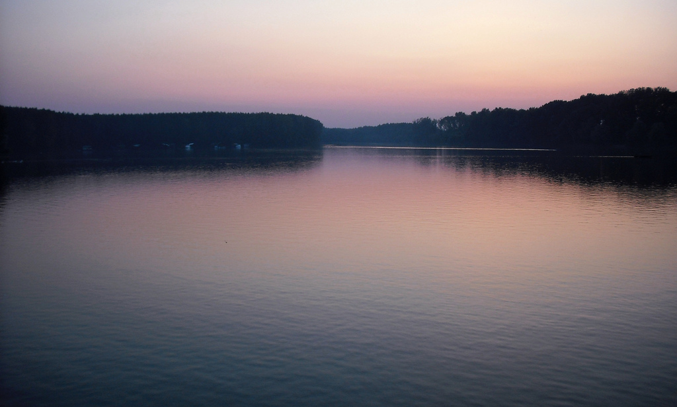
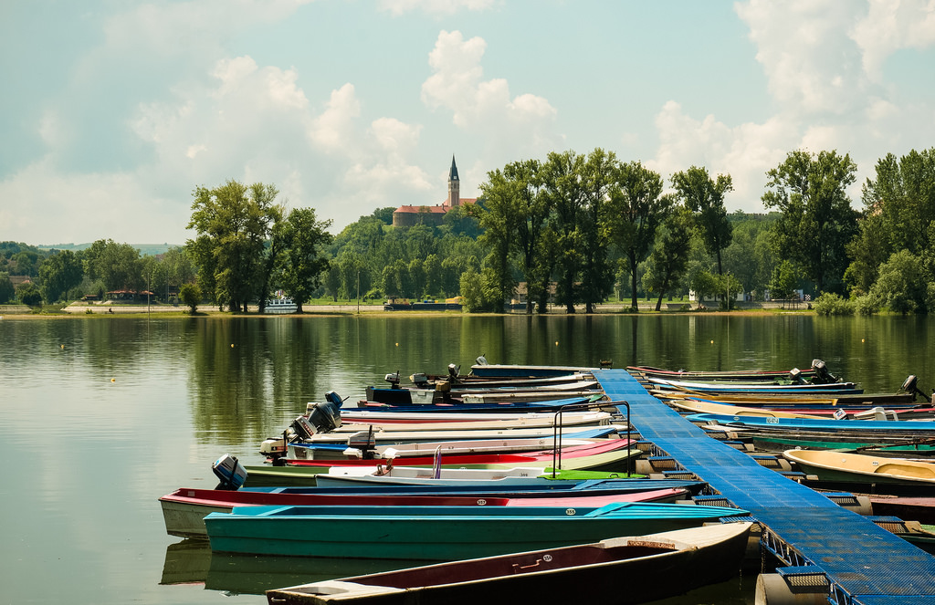
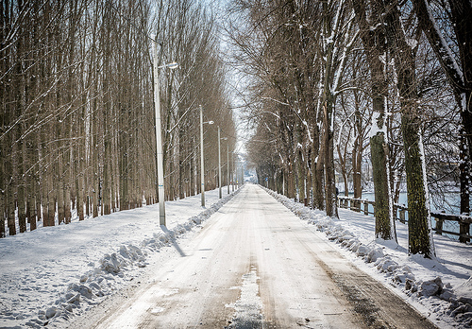
Park prirode “Tikvara”
Park of nature “Tikvara”

Slide 10
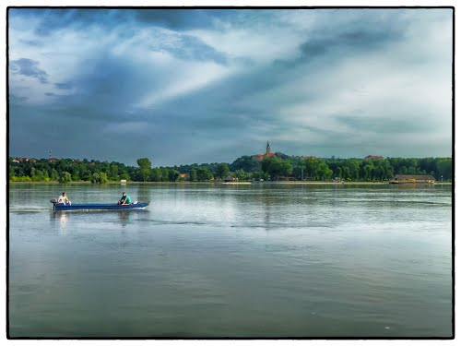
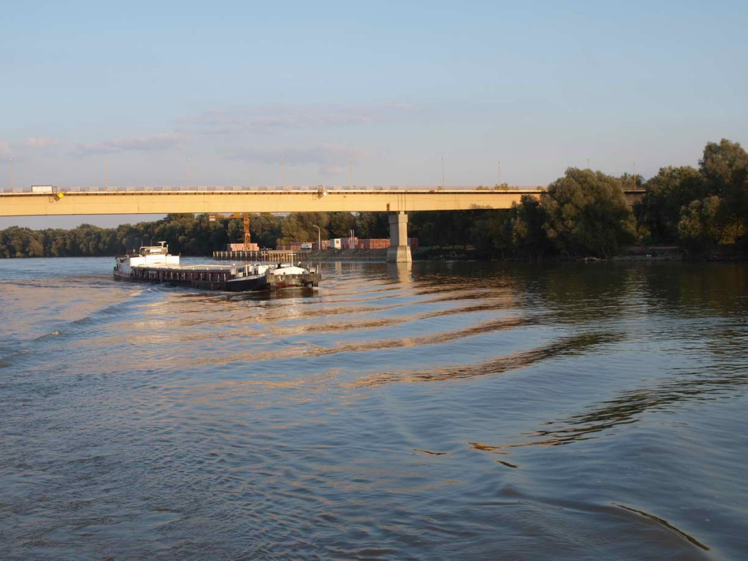
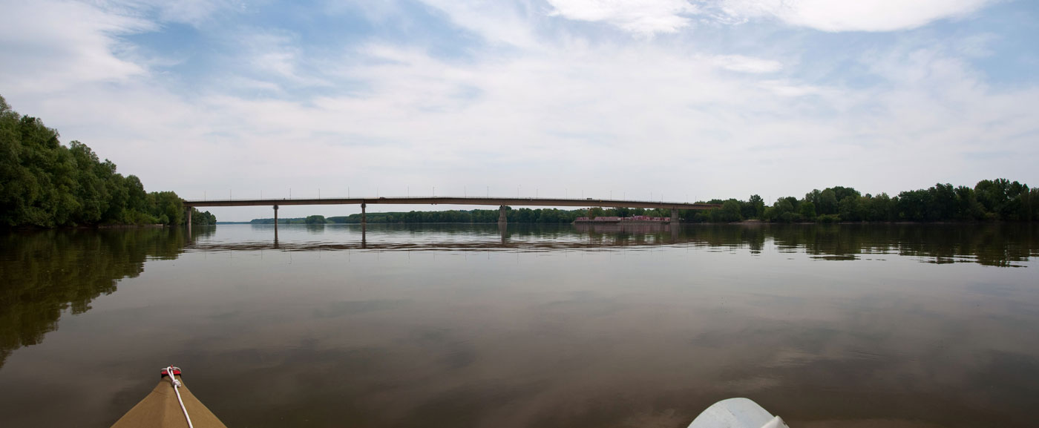
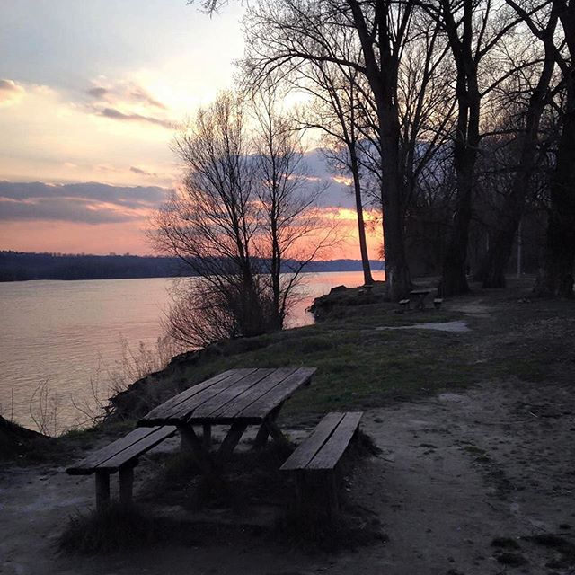
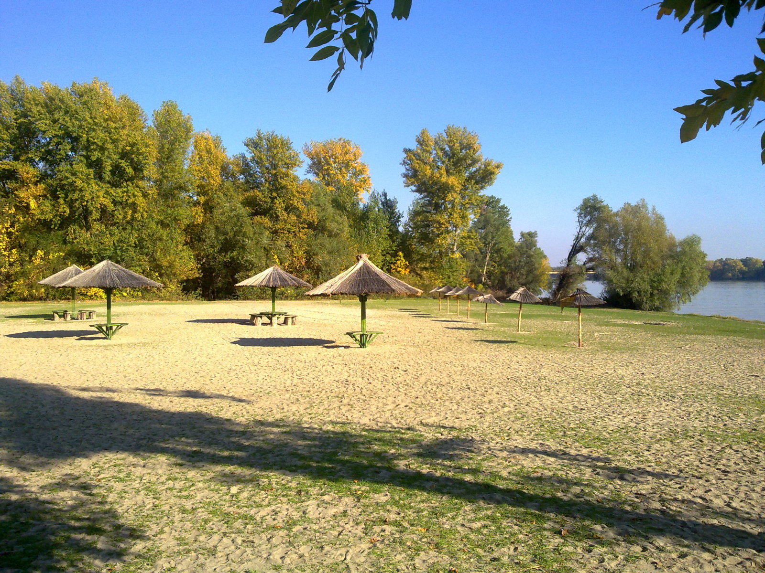
Dunav
Danube

Slide 11
Sport
Sport u Bačkoj Palanci je veoma popularan…
Sport in Backa Palanka is a very popular…

Slide 12
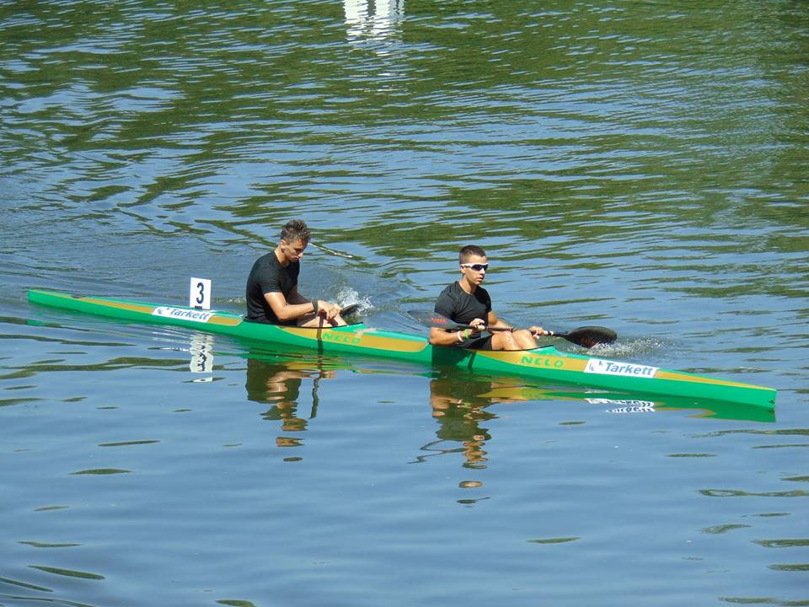
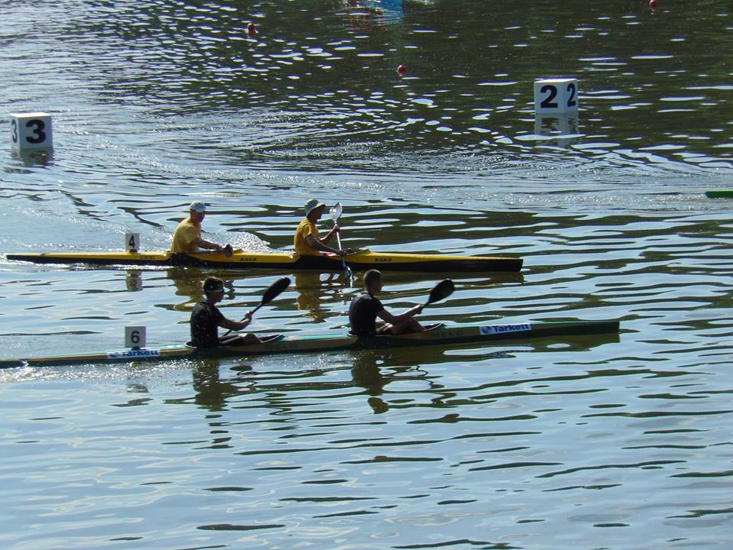
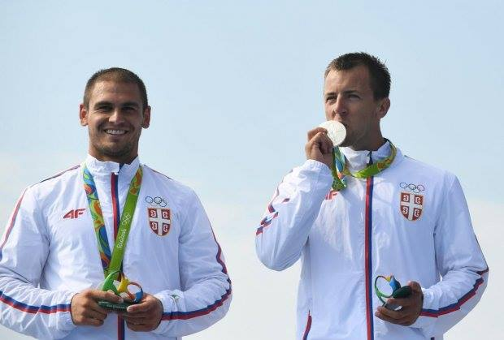
Kajak- Kayak

Slide 13

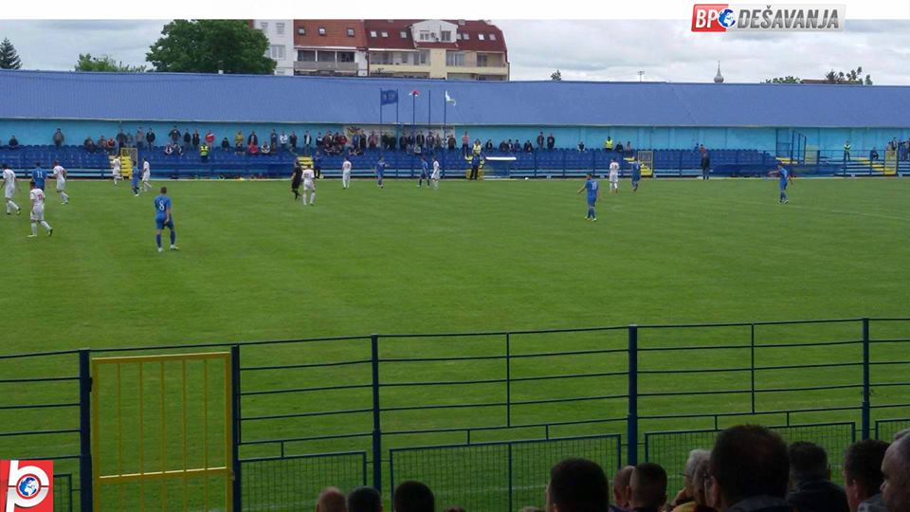
Fudbal-Football

Slide 14

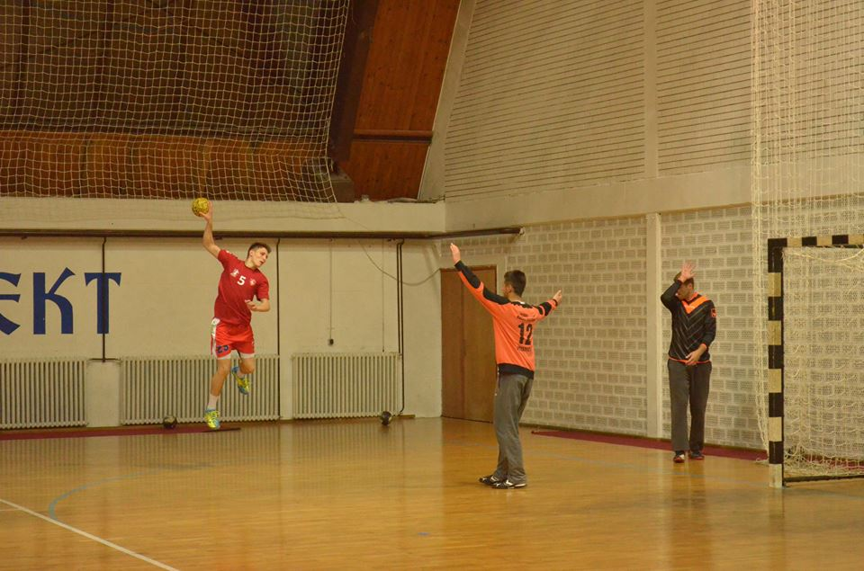
Rukomet - Handball

Slide 15

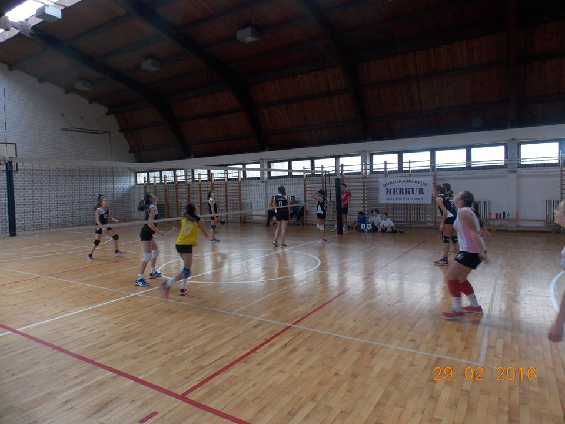
ODBOJKA-VOLLEYBALL

Slide 16

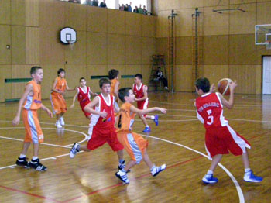
KOŠARKA-BASKETBALL

Slide 17
Manifestacije-Events
Neke od manifestacija u Bačkaoj Palanci su..
Some of the events in Bačka Palanka is..

Slide 18


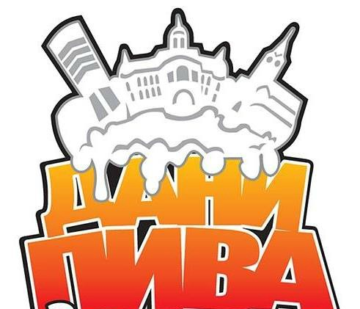
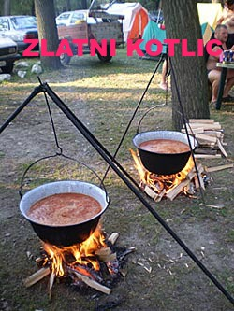
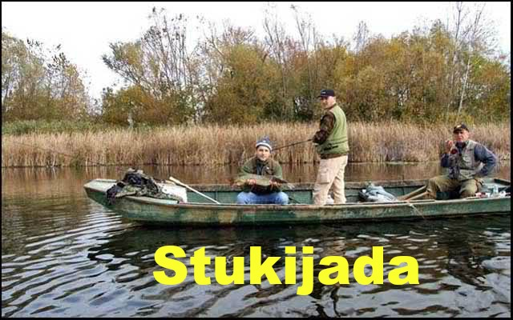
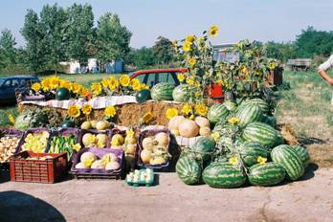

Slide 19
PRIVREDA-ECONOMY
Bačka Palanka je poznata po proizvodnji i prodaji tepiha i podnih obloga Sintelon i Tarkett.
Backa Palanka is famous for manufacturing and selling carpets Sintelon and Tarkett.

Slide 20

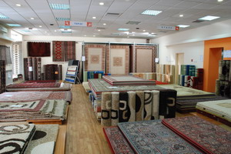

Slide 21
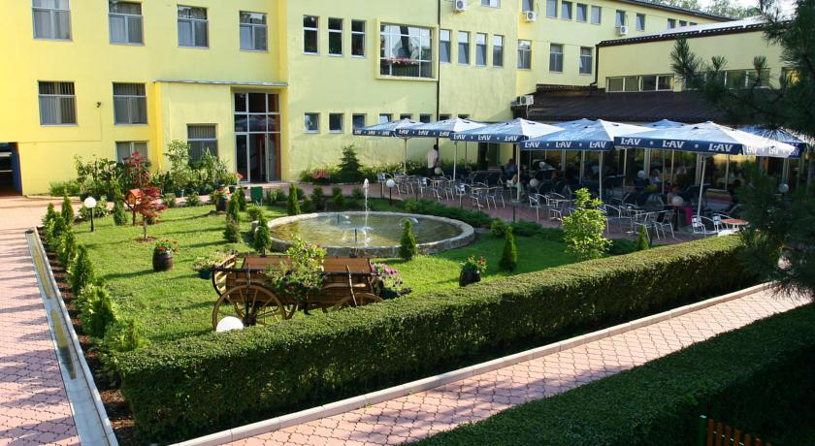
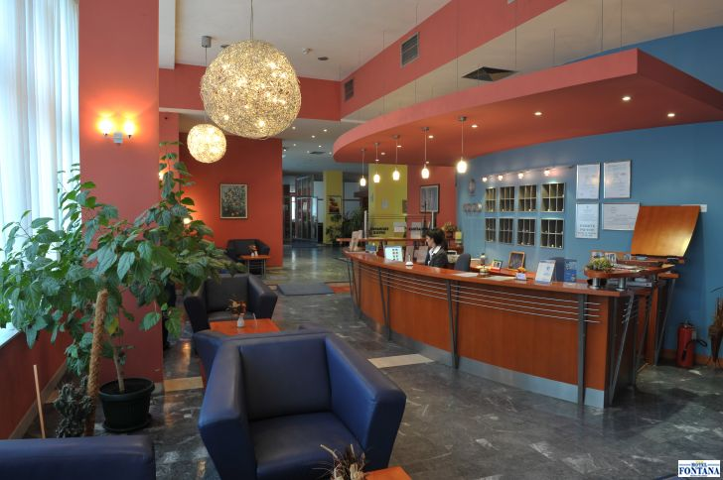
HOTELI-HOTELS

Slide 22
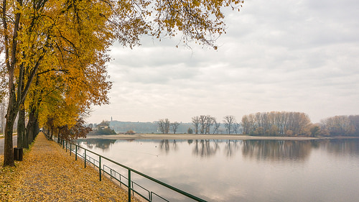
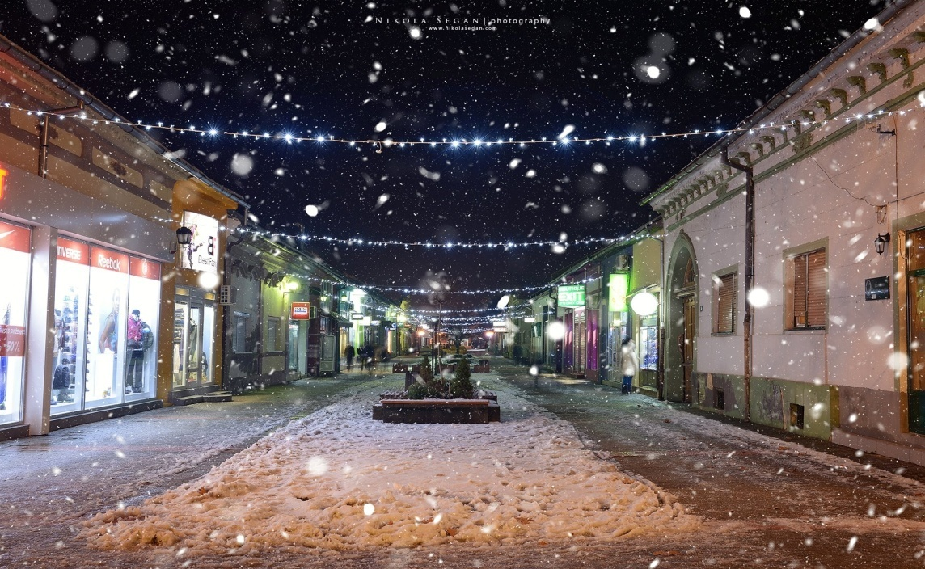
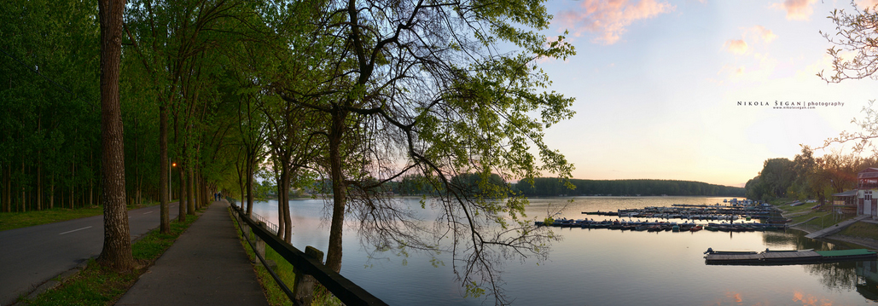
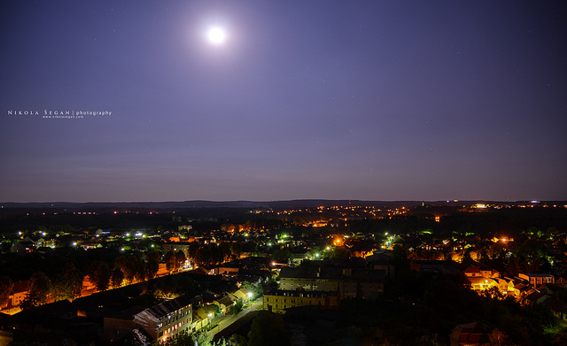
Godišnja doba-Seasons

Slide 23
Moja škola
My school
Moja škola je Srednja stručna škola “Dr Radivoj Uvalić” Bačka Palanka
My school is Secondary vocation school “Dr Radivoj Uvalić” Bačka Palanka

Slide 24
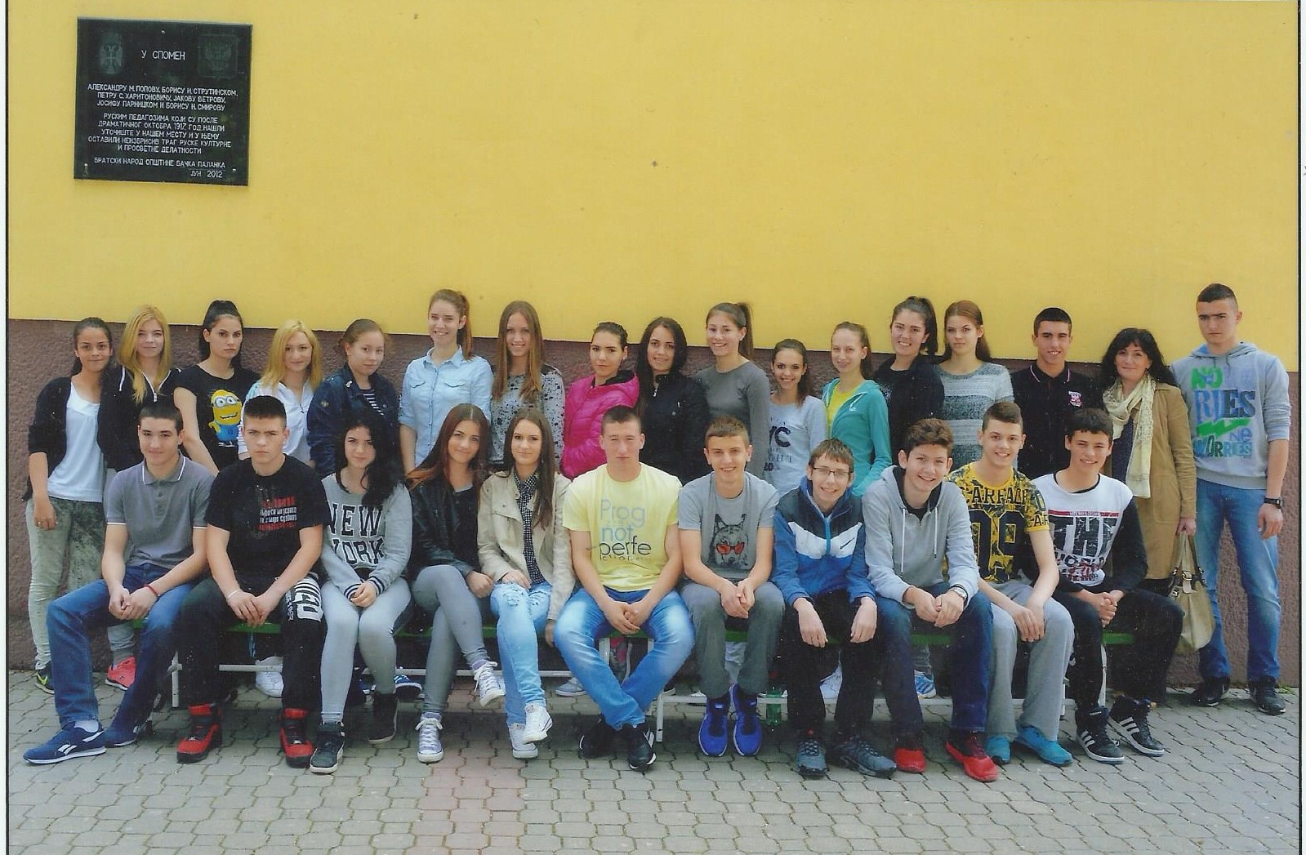
Ovo je moje odeljenje
This is my class

Slide 25
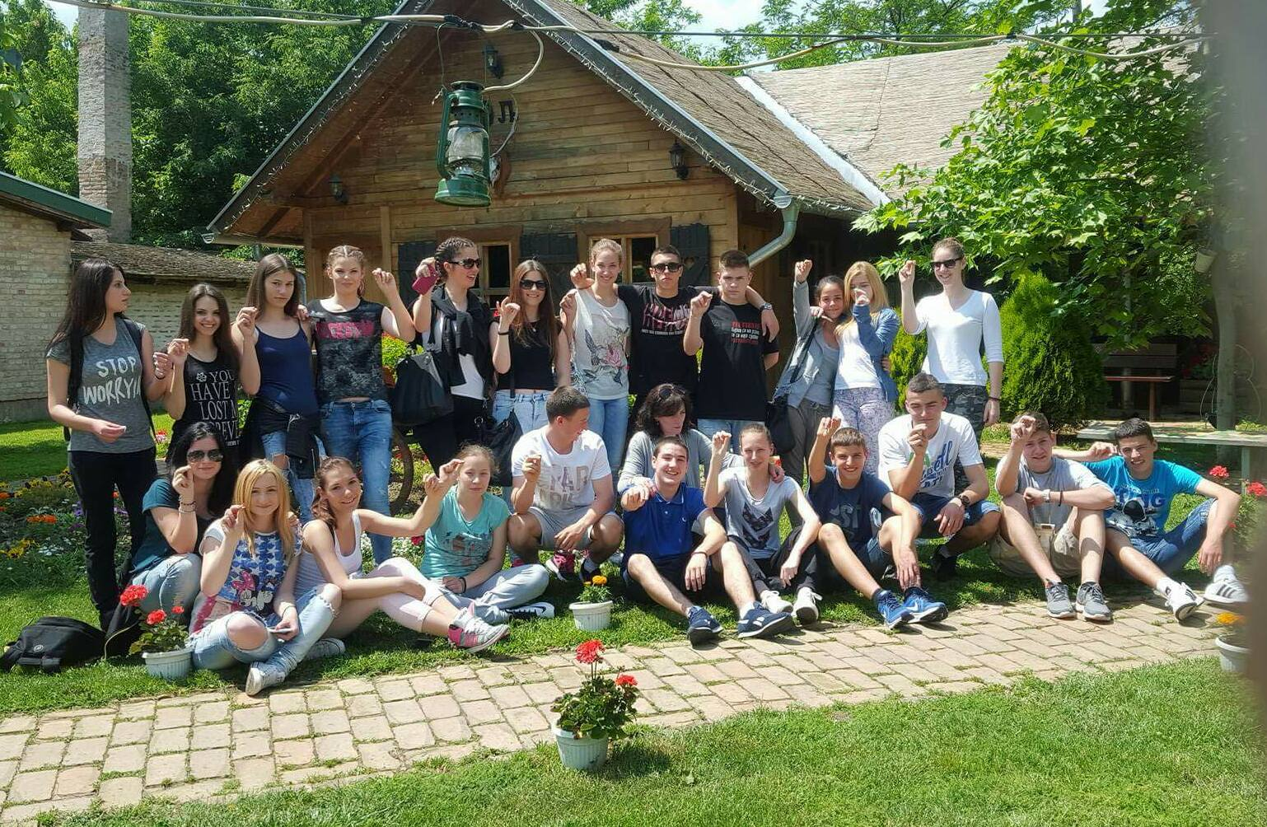
Turistički tehničar, druga godina
Tourism technician, second year

Slide 26
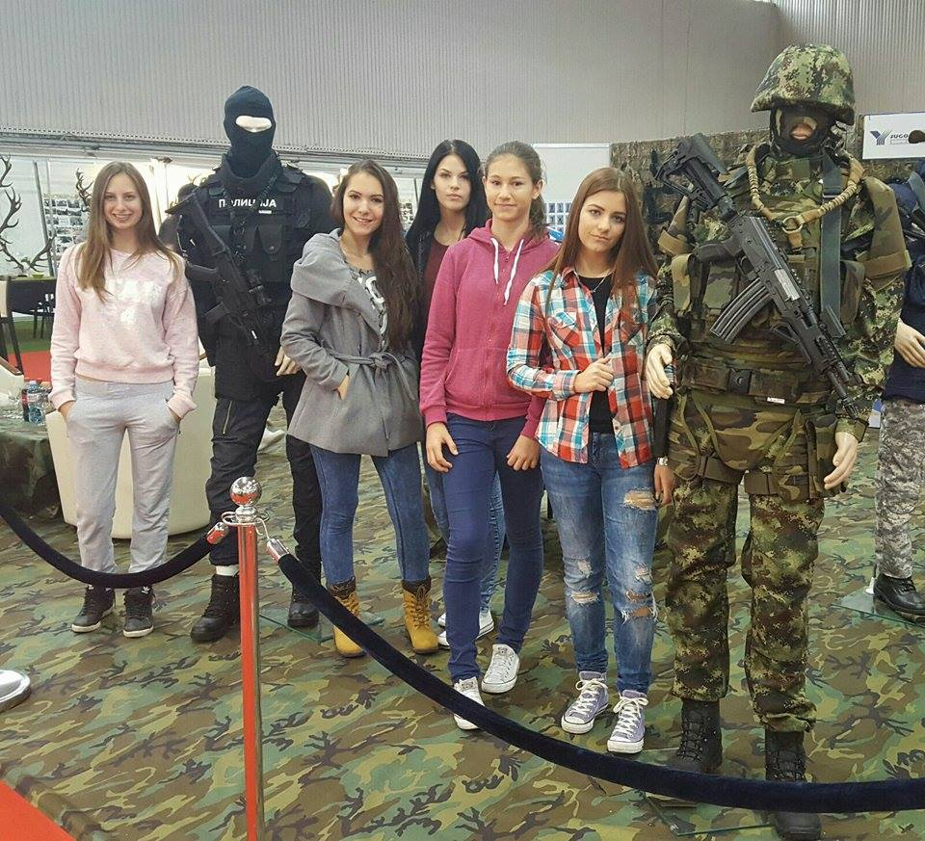
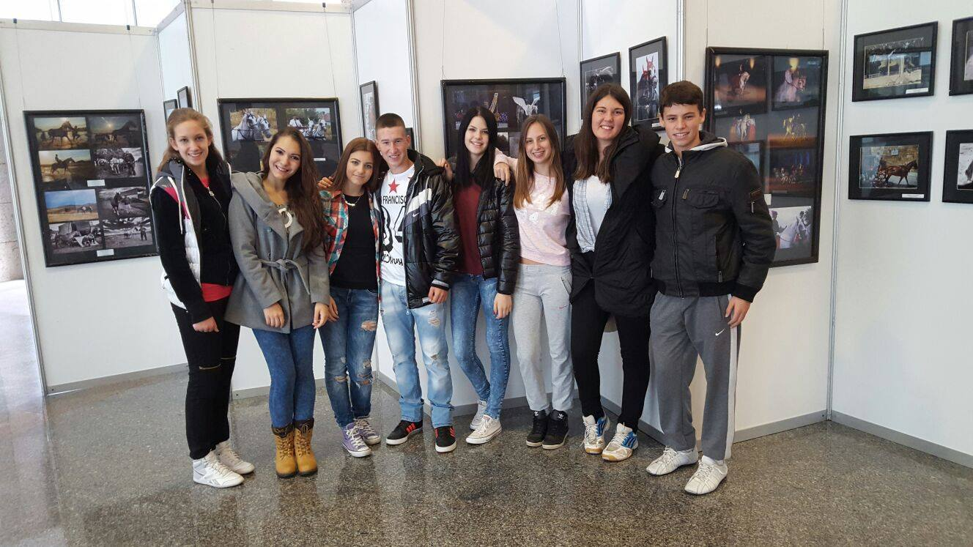
Školska godina nam je ispunjena putovanjima, družimo se i pomažemo jedni drugima.
Our school year is filled with little journeys, we hang out and help each others.

Slide 27
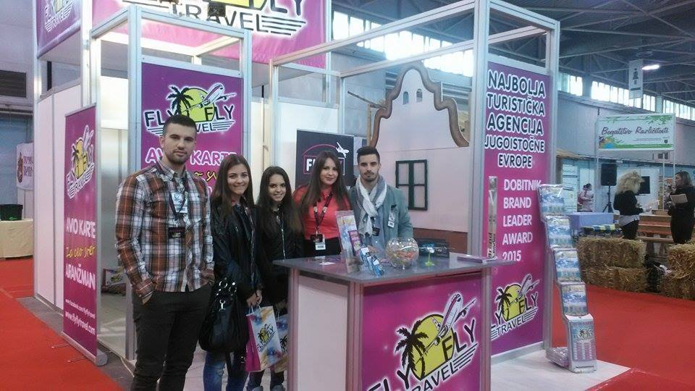
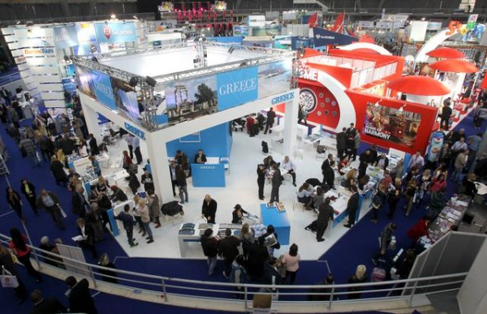

Slide 28
Hvala na pažnji!
Thank you for your attention!

Slide 29
Nastasja Pandurov
Tamara Ničić
II-4

